Slide 1
Monday September 23 Bell Work formal discussion

Slide 2
Objectives
Lesson Obj: WWBAT
Describe what matter is made of and differentiate between types of mixtures.
Daily Obj:
Today I will analyze new material in the textbook then conduct an hands-on, inquiry based activity over the new information.
I will know I have achieved this when:
I can differentiate between two types of mixtures.
Essential Question
What are two types of mixtures?

Slide 3
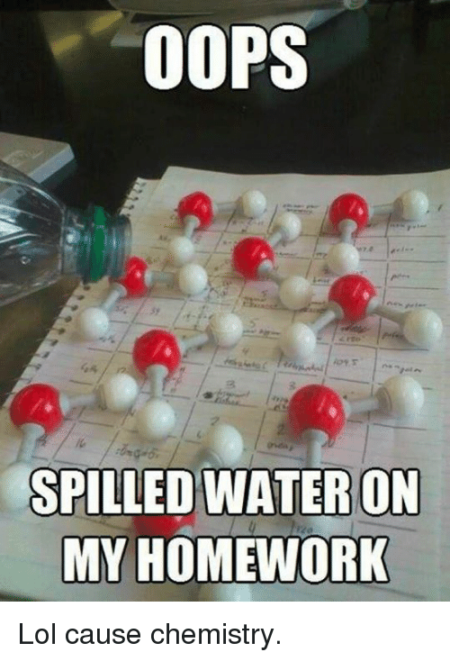
Today
Bellwork
16-17
QL: Separating Mixtures

Slide 4
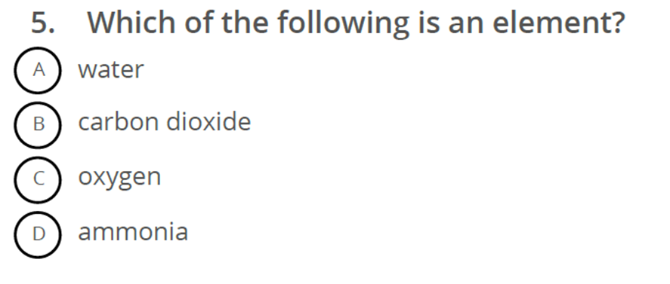
Bell Work formal discussion

Slide 5
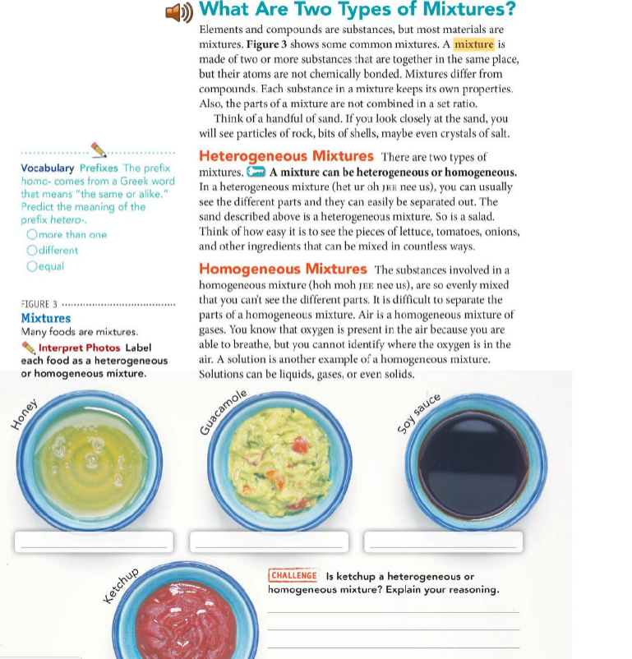

Slide 8
Closure
Define Homologous Mixture
Define Heterogeneous Mixture

